Slide 1
Hello and welcome to Car Buying
for the Savvy Consumer: Module 3
Closing the Deal.
During this training session you
will learn about sales techniques,
negotiating the deal, and
reviewing the contract. The last
slide lists websites which apply
to this module
This training consists of 12 slides
and should take approximately
20 minutes

Slide 2
Points To Ponder
Before you get started we would like you to take a couple of minutes to read the
following questions. Look for the answers as you review this module.
When negotiating for a new or used car I should negotiate these steps in order
    A. The price of the car, the amount for the trade in, then monthly payment amount
    B. The monthly payment amount, the price of the car, the financing
    C. The price of the car, the financing, the trade-in
    D. The financing, the price of the car, the trade-in
The dealership is required to refund my deposit if I decide not to buy the vehicle
    True
    False
I should review my contract carefully before signing it and do the following
A. Get copies every document before leaving the dealership
B. Double check all figures and make sure I do not leave any blanks on the contract
C. Take my time and make sure I understand everything
D. All of the above

Slide 3

Dealers Extra’s
Consumer Tip
Dealers make additional profit on selling you extras which usually can be purchased cheaper and at a later date. Evaluate each item carefully to determine if you really need it.
Pin Striping/Customizing/Detailing
Vehicle Protection Packages
  - Roadside assistance & rental vehicles - (does
  your warranty or insurance company provide
  roadside assistance and rental cars?)
  -scratch removal, touch up paint
Credit life insurance
  - this pays off the vehicle in case of death. Ask
  yourself how much insurance do you already have
  and is it enough (SGLI). If you need additional
  insurance consider buying a term life insurance
  policy.
Service warranties
- see slide on auto service contracts located in
  module two Inspections, Warranties, and
  Financing.
Pre-paid maintenance

Slide 4

More Dealers Extra’s
Consumer Tip
Don’t let your guard down just yet. The Financing & Insurance (F&I) Department manager will try to sell you additional items. You do not have to buy these “extras.”
Security / alarm systems
VIN etching
  - shop around for the best deal as you may be
  able to purchase this cheaper at a later date.
  - contact your insurance company for more
  Information and to see if your insurance company
  will provide a discount
Gap insurance
  - if you owe more on the car than it is
  worth your insurance company will only
  pay what the car is valued at.
  - you might consider gap insurance if you
  did not place a large enough down
  payment on your vehicle to cover the
  difference (TT&L, extras, depreciation)
Bad Credit – No Credit – No Problem
- expensive and costly.
- dealer may use subprime lenders & last chance financing lenders

Slide 5
Sales Techniques
Tactics
Bait & Switch
  - the purpose of the ad is to get you to
  the lot
  - salesperson will try to sell you a different
  car which they say better fits your image
Affordable monthly payments
  - You should focus on the whole deal;
  financing, price of car, etc. not just the
  monthly payments
Lowball/highball
  - setting a low price for the car you want to
  purchase or a high price for your trade-in.
  - later the salesperson comes up with a
  reason for not following through with that
  amount
How much were you thinking of putting down on the car?
  - don’t tell them you have a down payment
  until after you have negotiated the deal
Consumer Tip
There are a number of sources which further discuss sales techniques. Please do your research as we can only cover a few in this segment.

Slide 6
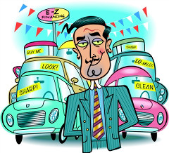
More Sales Techniques
Consumer Tip
Deposits are usually not refundable. If you leave a deposit ask if you can get your money back if you change your mind. Get this promise in writing!!!!!
What you might hear at the car lot
Today only
  - how many cars are in the central Texas
  area?
We will pay off your current loan
- negative equity added to your current loan
-contract might state you are still responsible for the next 45 days of payments.
Free food and other events
We need approval from the sales manager
  - this technique is meant to wear you down
  - the salesperson will try to put the blame
  on the manger
Negotiating Strategies
www.nadaguides.com/default.aspx?LI=1-20-9-5101-0-0-0&l=1&w=20&p=9&f=5102&a=8&as=37 (used)
www.nadaguides.com/default.aspx?LI=1-20-9-5101-0-0-0&l=1&w=20&p=9&f=5102&a=1&as=2 (new)

Slide 7

The Three Deals Of Car Buying
Consumer Tip
If at any time you feel pressured to act, are tired, or are unsure about the deal walk away. Limit the time you spend at the car lot and during negotiations
Keep each transaction separate
First step - Set the price
  - don’t discuss down payments, affordable
  monthly payments, financing, etc
  - negotiate the price of the vehicle you are
  looking at
  - this does not commit you to purchasing the vehicle
Second step - Arrange Financing
  - check your credit report and fix any errors
  before going to the dealership (discussed in
  segment two)
  - contact your financial institution to obtain pre-
  approval before going to the dealership
Third step - Negotiate Trade-in
  - if asked about a trade-in before this step
  divert the conversation to another aspect of
  the deal
  - determine the NADA value of your car
  before visiting the car lot or dealership

Slide 8
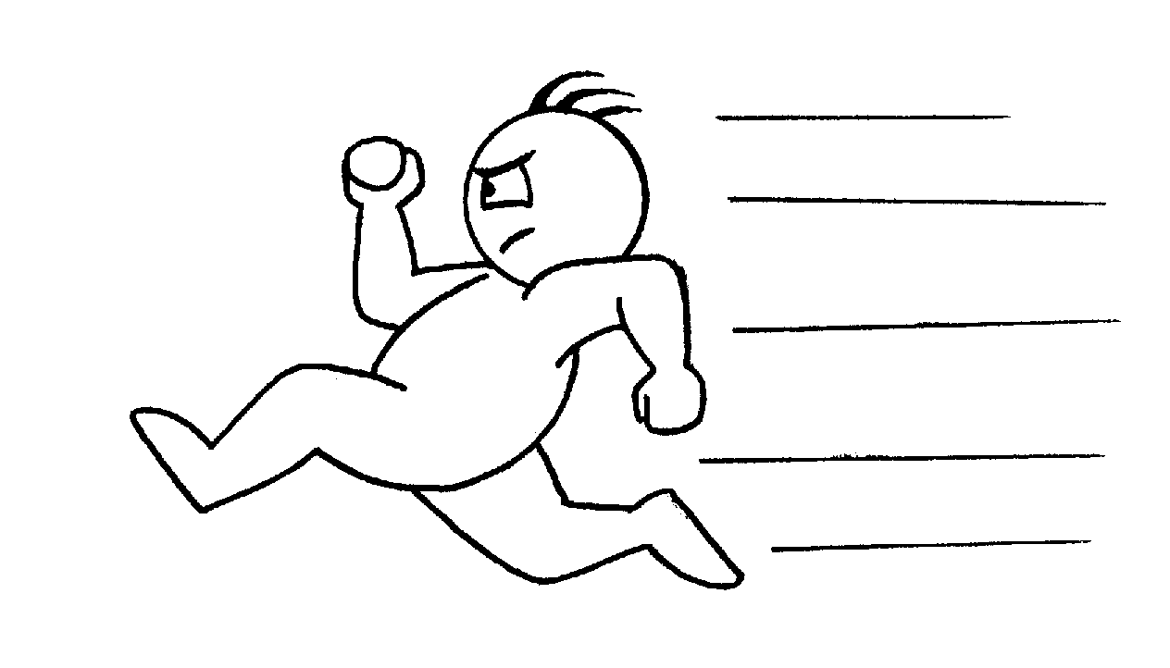
Remember These Basics
Consumer Tip
If you take the vehicle home overnight to check it out you will probably be asked to sign a statement. Look at both sides and make sure you are not signing a contract or any type of buyer’s order
Tips, Advice & Cautions
Control your excitement
Be ready to walk if not satisfied
Don’t bring the children
Don’t spend more than you budgeted for
Think about the deal overnight
Deposits are non-refundable unless you get it in writing
Write down the VIN of the car you test drive and make sure it matches the contract you sign.
How to be a Smart Negotiator
www.oag.state.tx.us/agency/weeklyag/2005/0605car.pdf

Slide 9

Get It In Writing
Consumer Tip
If you are unsure about any part of the contract ask to take it with you unsigned. Stop by your legal office and ask them to review your contract
If it’s not in writing it’s not going to happen
Double check all figures
Don’t leave any blanks
Get copies of all documents before you leave
Review your contract carefully before signing
Take your time
  - don’t allow yourself to be rushed
  - watch out for the “it’s in every contract,
  initial here, sign here, bit.”

Slide 10

Tips, Hints, Etc
Contract might not allow you to take car with you on PCS moves
Spot delivery
- when you take the vehicle home pending approval of the loan
  - limits your options if you are not approved
Shop around for insurance before signing the contract
  - ask your friends who they use and shop
  around for the best overall insurance
  - some dealerships may add insurance to your
  contract. You may still be required to purchase a
  separate liability policy through an insurance
  company
Negative Equity
-when you owe more than your trade-in vehicle is worth you are limiting your options.
  - contact your financial institution or your
  Battalion Command Financial Specialist for
  advice on how to avoid this situation
Consumer Tip
Bring a clipboard or notebook with you to the car lot. Write down every fact or figure and who made the promise. Review your contract before signing to ensure it is included.
Automobile Insurance Made Easy
www.tdi.state.tx.us/pubs/consumer/cb020.html

Slide 11
Alternate Buying Strategies
Methods
Phone the dealership
  - repeat figures and write them down
  - write down who you are talking to and
  the persons position
  - don’t give out your credit information
Use the Internet
  - auto buying services
  - referrals
  - dealers website
  - email
  www.bbb.org/us/article/144
Fax offers
Cautions (especially private dealers, online auctions)
- verify the source, read all disclaimers, refund policies and
fine print
- physically check over vehicle before sending money
- verify ownership of vehicle with DMV if a used vehicle
- do not wire transfer money or give out account information
Consumer Tip
Watch out for bait and switch tactics. When visiting the lot don’t tell the salesperson you already have a quote. Shop around and negotiate first to see if you can get a better deal.

Slide 12
Websites
Alternate Buying Strategies
Better Business Bureau
Purchasing a car online
www.bbb.org/us/article/144
Texas Department of Insurance
Automobile Insurance Made Easy
www.tdi.state.tx.us/pubs/consumer/cb020.html
Glossary of Auto Insurance Terms
www.tdi.state.tx.us/auto/autoglossary.html
Automobile Insurance Sample Rate Comparisons
https://apps.tdi.state.tx.us/helpinspublic/Start.do?type=auto
Negotiating the deal
Texas Attorney General
How to be a Smart Negotiator
www.oag.state.tx.us/agency/weeklyag/2005/0605car.pdf
How to get a great deal on a New Car
www.pueblo.gsa.gov/cic_text/cars/cardeal/cardeal.htm
Negotiating Strategies -NADA
www.nadaguides.com/default.aspx?LI=1-20-9-5101-0-0-0&l=1&w=20&p=9&f=5102&a=8&as=37
www.nadaguides.com/default.aspx?LI=1-20-9-5101-0-0-0&l=1&w=20&p=9&f=5102&a=1&as=2
Miscellaneous
Edmunds.com Confessions of a Car Salesman
www.edmunds.com/advice/buying/articles/42962/article.html?tid=edmunds.a.landing.feature..3.*

